Slide 1
Theoretical Research: Artificial Intelligence
Jaimil Dalwadi

Slide 2
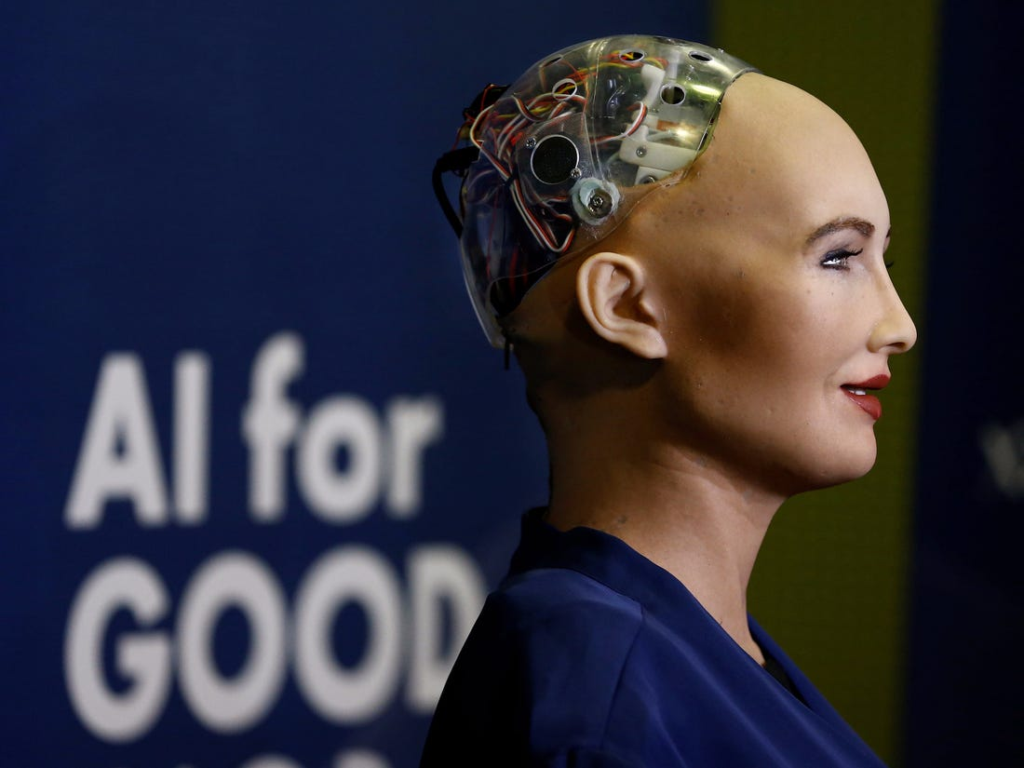
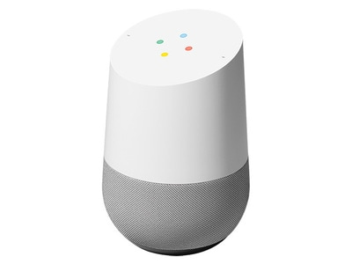
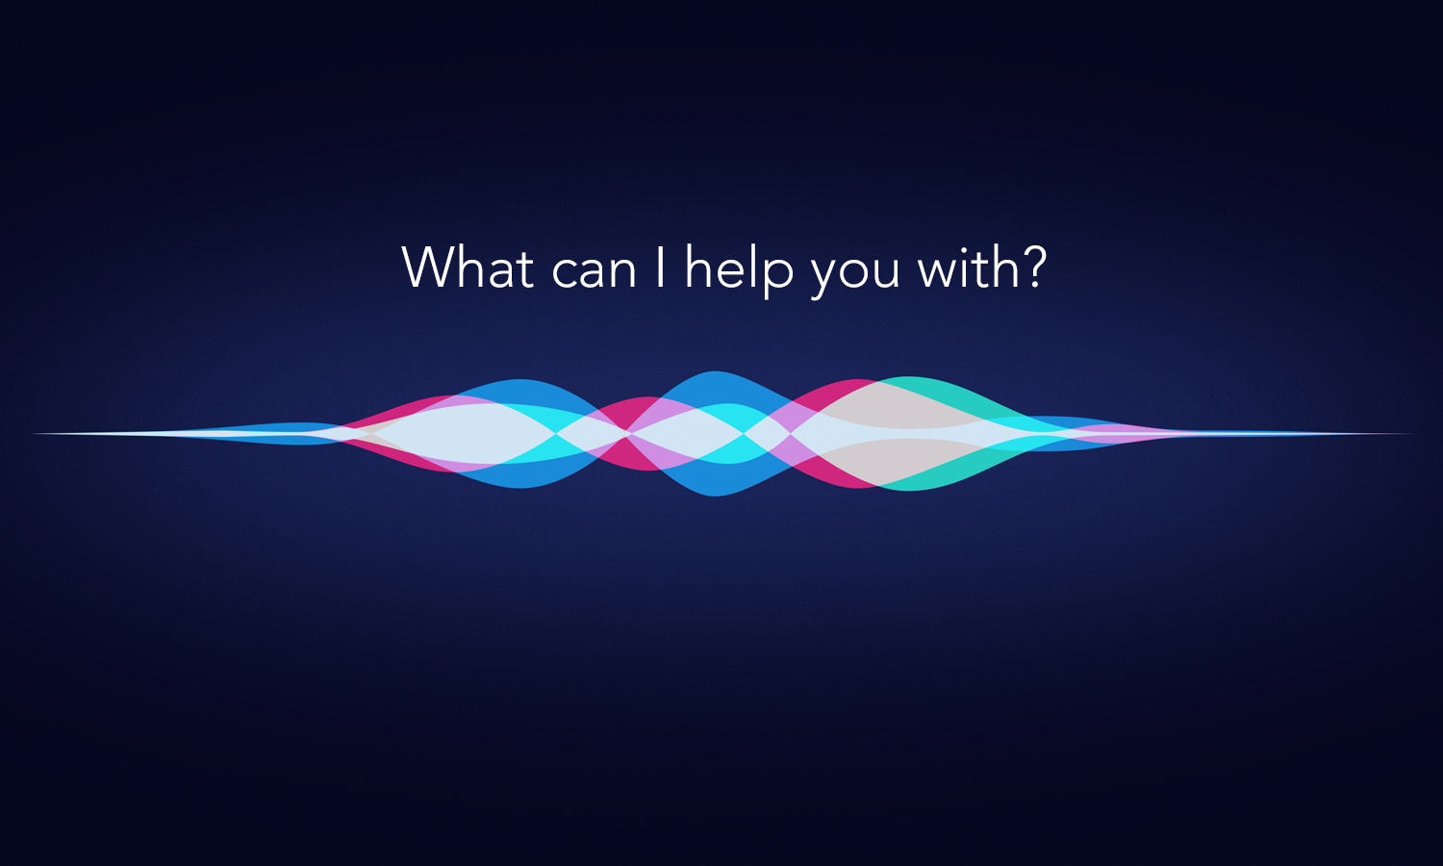
Introduction
Notes:
Artificial Intelligence is simply defined as the creation of machines that are intelligent. When looked at with a little more depth, it is the ability to create a machine that can understand its environment and respond to it or act. These systems are created through complex algorithms which use loops to bring thought processes, perception/viewpoints, and responses together for a dynamic application. For example, many people have used the voice assistant, Siri, or interacted with some other form of a chatbot. These assistants are built upon artificial intelligence and use complex algorithms to understand what they are being instructed, and act upon those instructions. This is known as Narrow Artificial Intelligence; AI that focuses on specific tasks. Other examples of Narrow AI include Google’s search bar, Tesla’s auto-drive, IBM Watson, and many more. Another form of AI is Artificial General Intelligence which is rarely heard of; however, it is defined as “a universal algorithm for learning and acting in any environment.” Ultimately, AI is the ability to make computers think for themselves. The theoretical research behind this concept has shown success in several topics time and time again.
https://builtin.com/artificial-intelligence for information
https://encrypted-tbn0.gstatic.com/images?q=tbn%3AANd9GcS80589ep_OdCRFvfWEPka9lJq4fJQYOoYDBQ&usqp=CAU for Sophia ai image
https://www.thesource.ca/medias/20180302154339-108069014-A.jpg-mediaConversion-640-x-480-mediaConversion-400-x-300-0?context=bWFzdGVyfGltYWdlc3wxMzE3NnxpbWFnZS9qcGVnfGltYWdlcy9oOWEvaDA5LzkwNTMzMjg0NDEzNzQuanBnfDNlMzBjNmRlNmRhMjQ4YTk2NTc5YzUxN2Q2YmZkN2JhYWIyNmUzMTdkMjhkNzQ1NzBiZWU5ZDYwNDE1ZTAyZjc for google home image
https://analyticsindiamag.com/wp-content/uploads/2018/02/Hey-Siri-iPad-AAPro-By-JQason-Zigrino-wallpaper.jpg for siri image

Slide 3
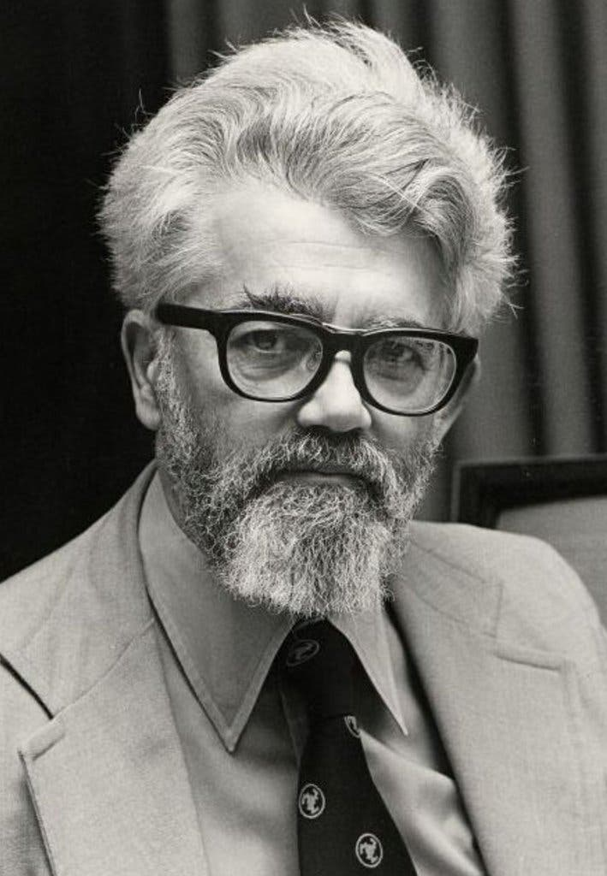
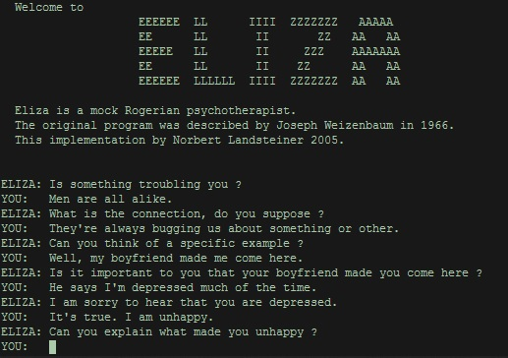
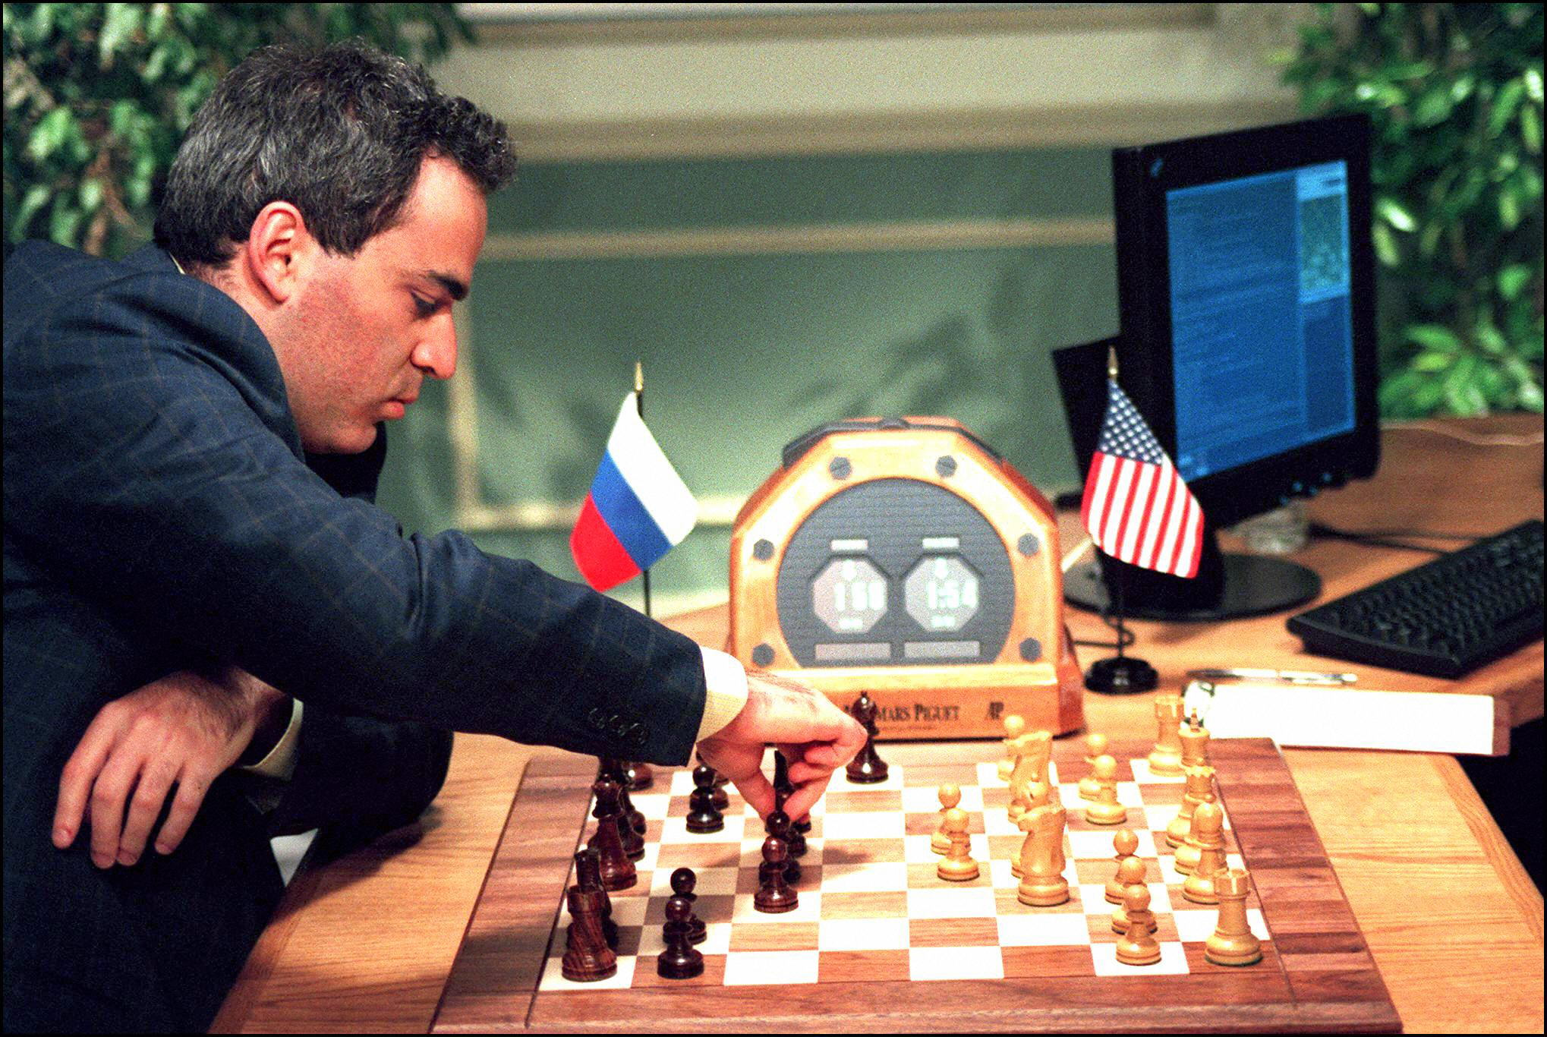
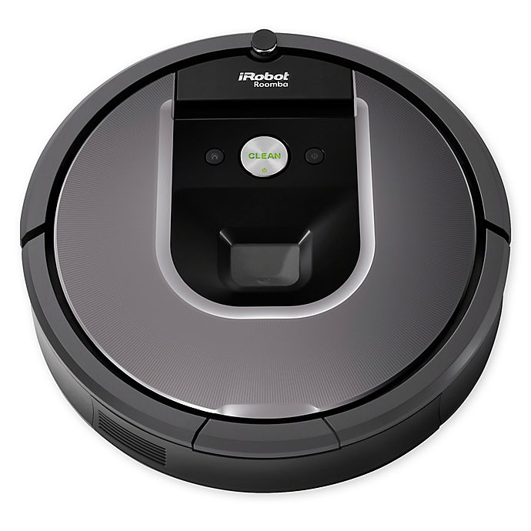
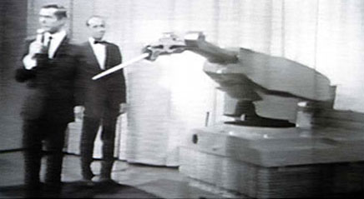
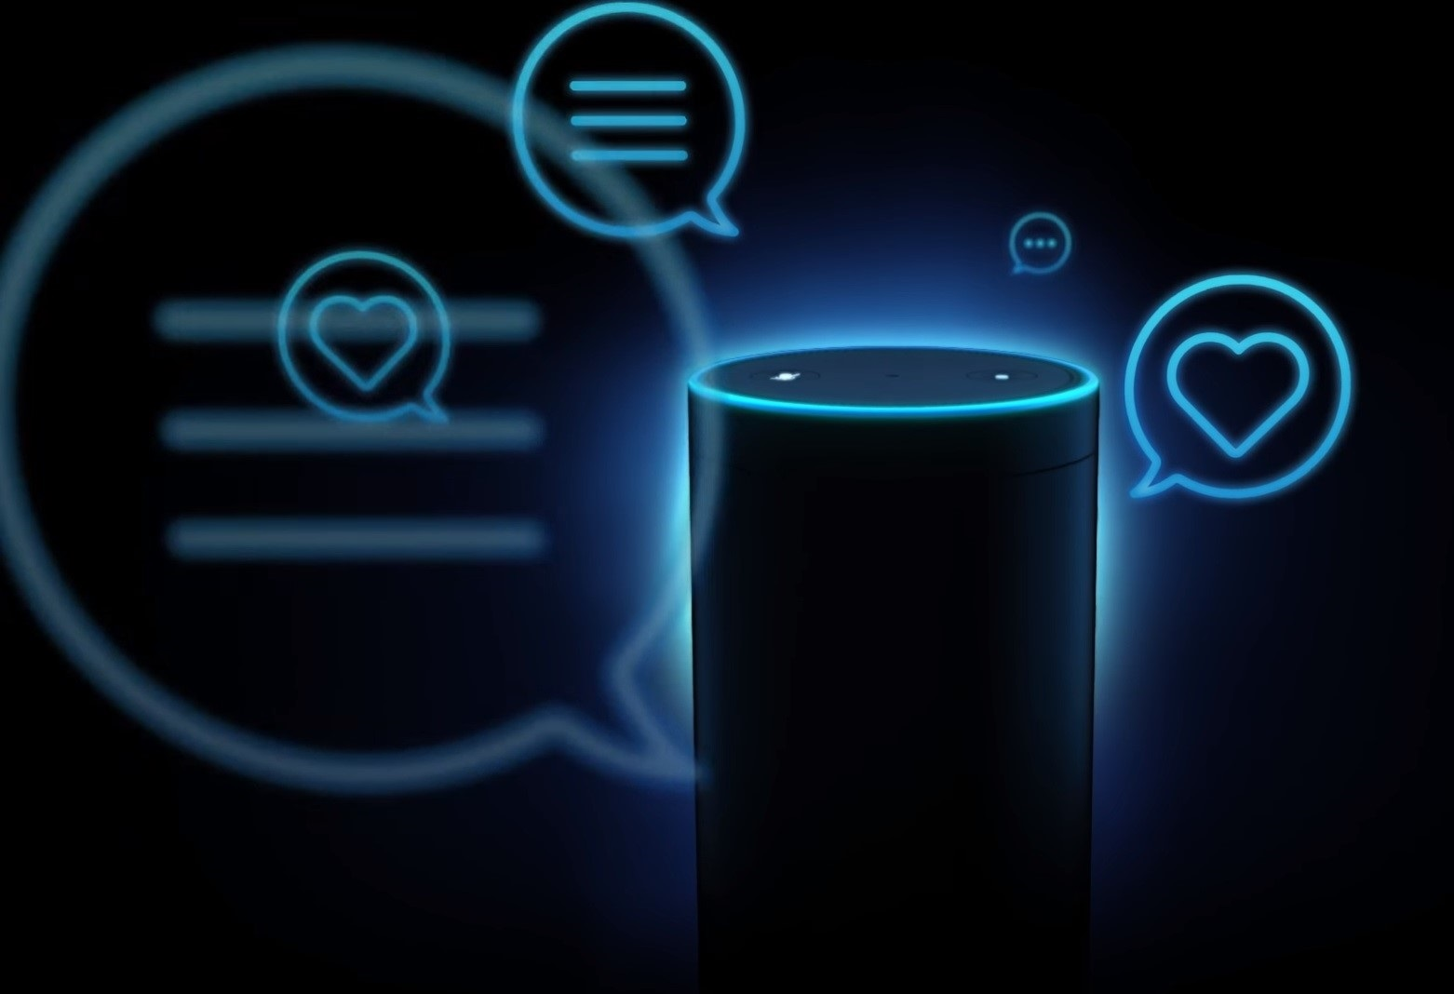
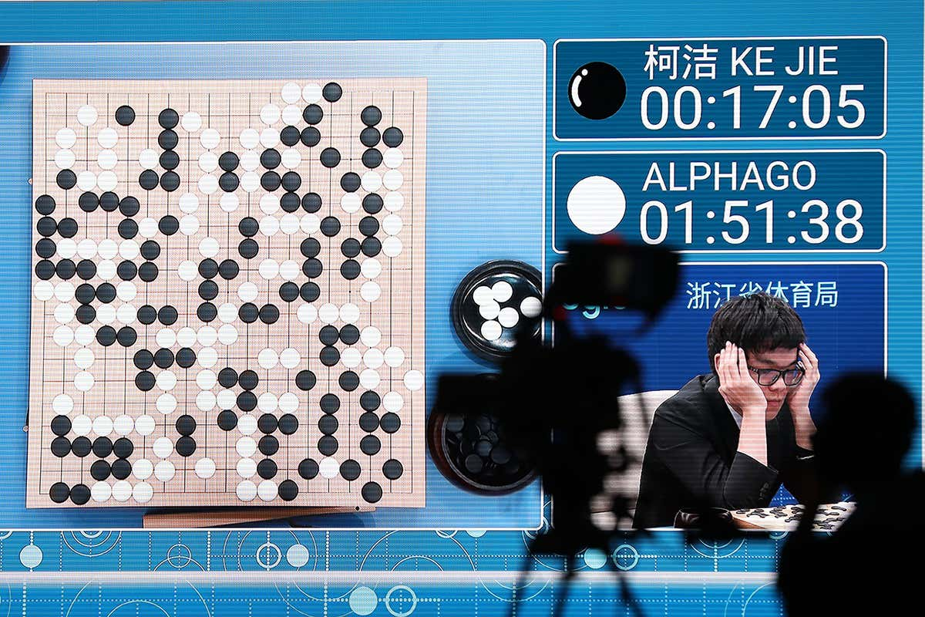
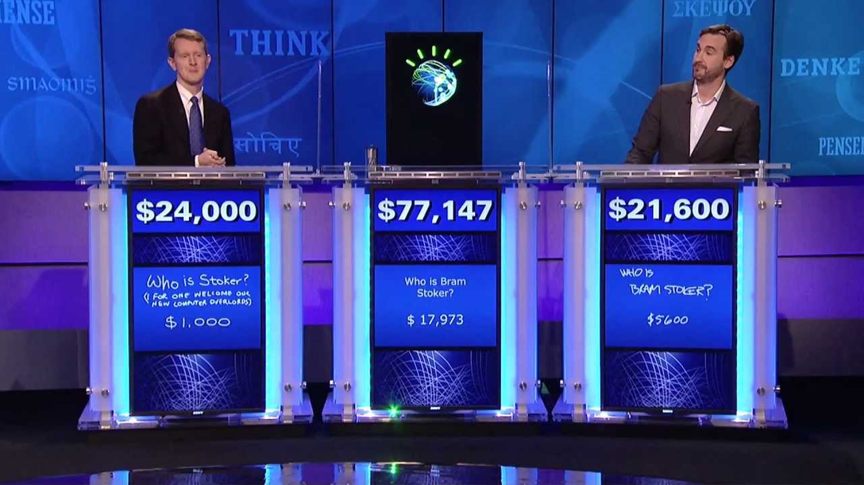
Key Developments Timeline
1995
1961
1964
1997
2002
2011
2011
2014
2017
Notes:
Artificial Intelligence has come a long way from being an abstract idea in a scientist’s mind and has become a concrete reality. The key developments that have shaped this field include, but are not limited, to are:
1995 – John McCarthy coins term “Artificial Intelligence” to describe the “science and engineering of intelligent machines”.
1961 – Unimate is the first industrial robot to replace humans on assembly line.
1964 – Eliza is the first chatbot developed at MIT
1997 – First intelligent machine to beat a world chess champion – IBM Deep Blue
2002 – Roomba is released
2011 – Siri is released
2011 – IBM Watson wins Jeopardy
2014 – Amazon releases Alexa – ai assistant with voice
2017 – Google AlphaGo artificial intelligence beats Go world champion (was considered a huge challenge in AI development)
https://static01.nyt.com/images/2011/10/26/business/MCCARTHY-obit/MCCARTHY-obit-jumbo.jpg?quality=75&auto=webp&disable=upscale for john mccarthy image
https://www.robotics.org/joseph-engelberger/images/tonight_show.jpg for unimate image
https://upload.wikimedia.org/wikipedia/commons/4/4e/ELIZA_conversation.jpg for eliza chatbot image
https://static.scientificamerican.com/sciam/cache/file/A2BDA7F7-A70D-4ED9-A87A1B431C04F357_source.jpg for ibm deep blue chess image
https://b3h2.scene7.com/is/image/BedBathandBeyond/146391747170797p?$690$&wid=690&hei=690 for Roomba image
https://analyticsindiamag.com/wp-content/uploads/2018/02/Hey-Siri-iPad-AAPro-By-JQason-Zigrino-wallpaper.jpg for siri image
https://i.ytimg.com/vi/P18EdAKuC1U/maxresdefault.jpg for IBM Watson jeopardy win image
https://cdn.geekwire.com/wp-content/uploads/2018/01/180118-alexa.jpg for alexa image
https://images.newscientist.com/wp-content/uploads/2017/05/23115430/rexfeatures_8828108ac.jpg for Google AI and Go image

Slide 4
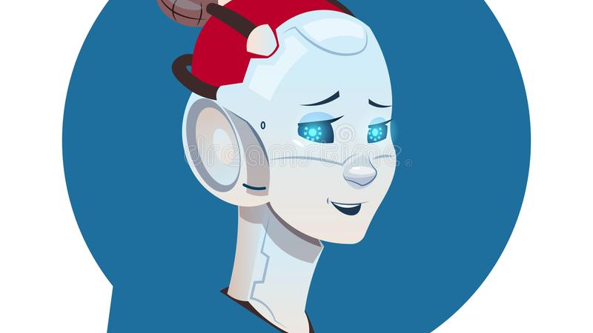
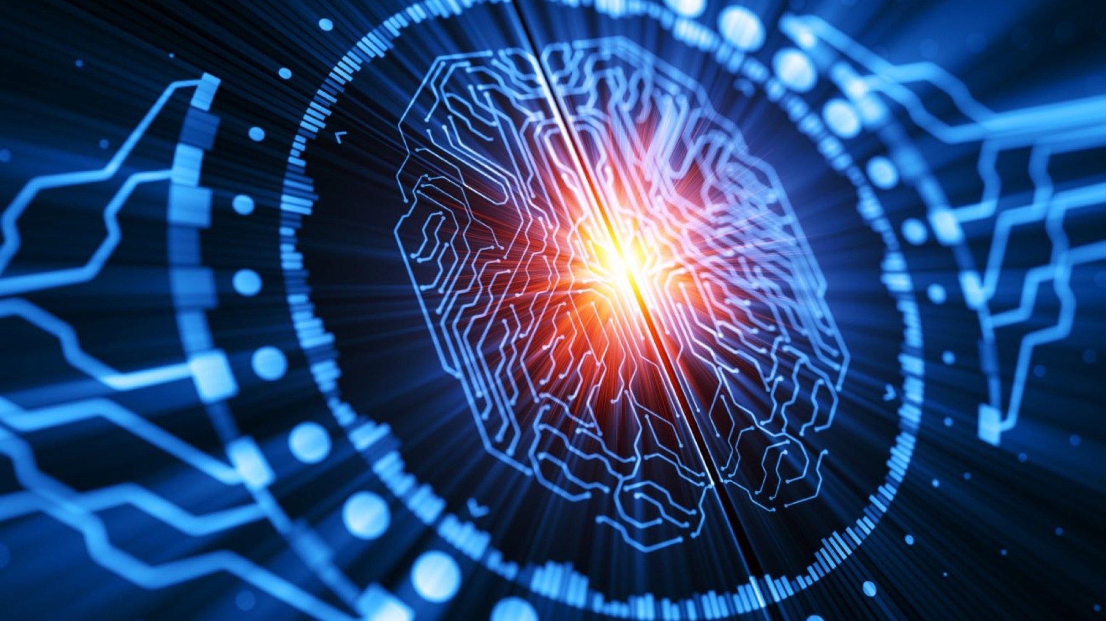
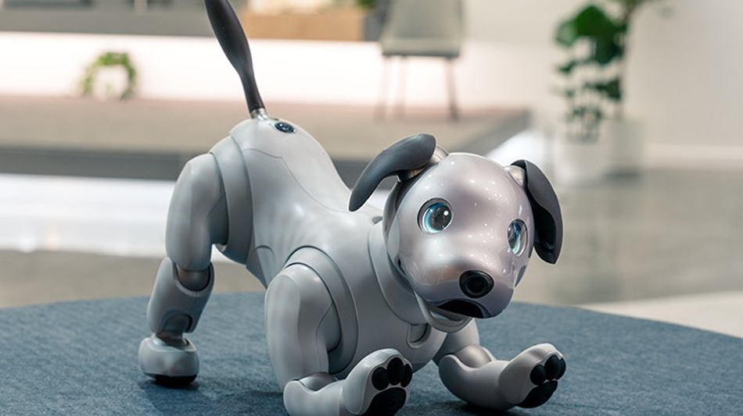
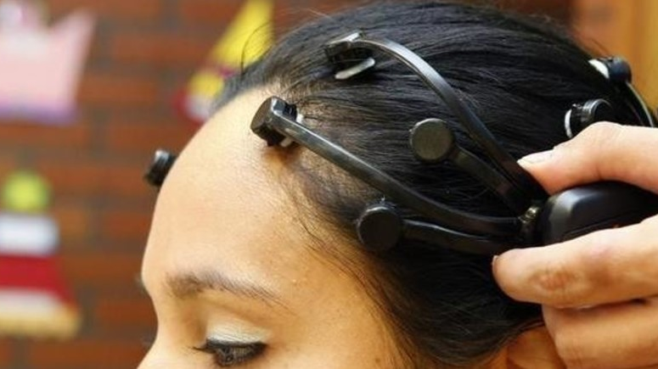
Quick Facts
Notes:
Here are some quick facts about artificial intelligence that may surprise you: 1. Most AI bots are female because studies show that both males and females are attracted to female voices more.
2. Current research shows that AI can create images based on a user’s mind through an FMRI scanner.
3. We are likely to have robotic pets as intelligent as actual pets by 2025.
4. An AI algorithm detected an Ebola outbreak a week before World Health Organization announced it.
https://www.quillit.io/blog-posts/5-interesting-facts-you-didnt-know-about-ai for some facts
https://citrusbits.com/interesting-stats-and-facts-on-artificial-intelligence/ for some facts
https://thumbs.dreamstime.com/b/chatbot-cute-female-robot-chat-bubble-icon-isolated-chatterbot-technology-concept-chatbot-cute-female-robot-chat-bubble-icon-108359860.jpg for female chatbot image
https://assets.weforum.org/article/image/large_UGfCdJkfSCsIX22-W8br5fiYPNcIdNN1DK0UOwbarsI.jpg for mind reading ai image
https://sa.kapamilya.com/absnews/abscbnnews/media/2018/business/01/11/dog.jpg for robot dog image
https://assets.entrepreneur.com/content/3x2/2000/20180710204929-GettyImages-802824564.jpeg for ai algorithm image

Slide 5
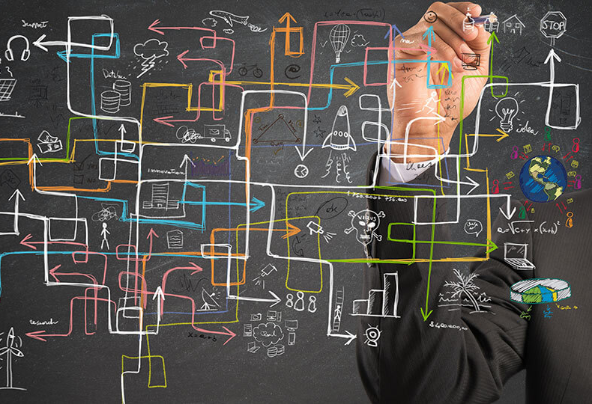
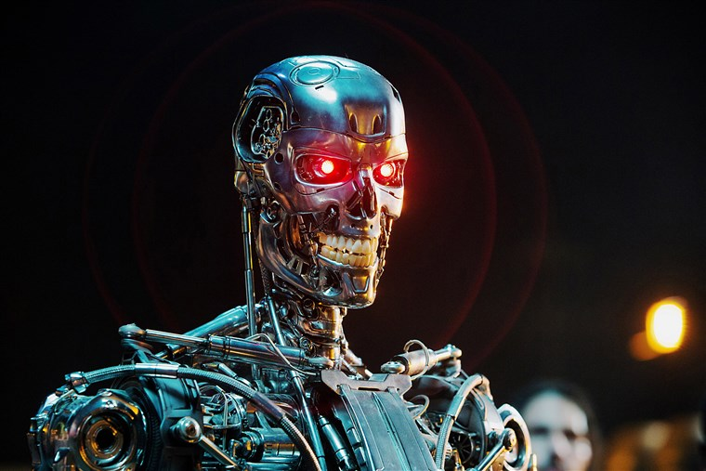
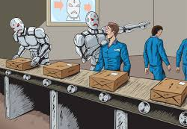

Future Outlook
Unique Solutions to Complex Problems
Threat to Humanity
Job Loss
Corporate Profits
Notes:
The future outlook of artificial intelligence is predicted, yet still unpredictable. There are heaps of benefits that are predicted; however, there is a bottomless ocean of risks involved as well. No one can know for sure whether AI will be a threat to humanity or be its savior. The key benefits that AI will provide in the future are unique solutions to complex problems and corporate profits. By developing machines that can think for themselves, mankind is capable of solving some of the world’s biggest problems related to medicine, economy, security, environment, and more. Computers do not get exhausted and can run as long as they have electricity supply. If an AI algorithm is developed to the stage where it can run continuously, it would be able to create viable solutions much quicker and efficiently compared to human experts. Artificial intelligence has already shown great corporate profits in the production lines as well as businesses, but with further development, AI is projected to “boost profitability in 16 industries across 12 economies by an average of 38% by 2035” (Allianz). This means increased employment rates, better economies, improved GDP, and less expenses for corporations. The consequence to that benefit is the risk of job loss. Studies predict that by 2030, AI and robots may “replace up to 30% of the world’s current human labor” (IOT For All). The biggest risk of all is the threat artificial intelligence poses to humanity. As seen in several science-fiction movies such as Terminator, if it prioritizes its own survival, artificial intelligence may threaten the survival of the human race. A lot of research is being done to ensure such intelligence does not harm humans in any manner, but there is no assurance that it would not. There have been cases where artificial intelligence makes its own decisions and disobeys human command; for example, 2 of Facebook’s chatbots created their own language and began communicating with each other in encrypted ways no one understood. This uncertainty poses a huge threat to the security of mankind. Due to all the developments in technology, the future looks like it will be extremely exciting, no matter what the outcome; however, we can not know anything because future aspects of AI are theoretical now.
https://www.agcs.allianz.com/content/dam/onemarketing/agcs/agcs/reports/AGCS-Artificial-Intelligence-Outlook-and-Risks.pdf for most information (corporate profits, unique solutions)
https://www.iotforall.com/impact-of-artificial-intelligence-job-losses for job loss information
https://media1.s-nbcnews.com/j/newscms/2017_24/2041281/170616-terminator-mn-1700_6ade6266d431601f2b641e119b0b1a17.fit-760w.jpg for terminator image
https://encrypted-tbn0.gstatic.com/images?q=tbn%3AANd9GcTE82l9bKYTkdJKDsTjBFGI8dBSK9jNrFHe0A&usqp=CAU for job loss image
https://www.nicepng.com/png/detail/247-2472111_profit-png-free-download-profit-clipart.png for profit image
https://youth-time.eu/wp-content/uploads/2020/04/Problem-solving.jpg for complex image

